Slide 1
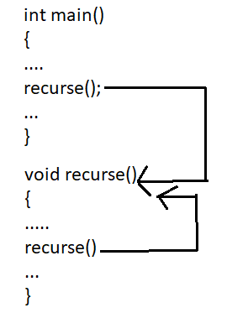
RECURSION
The process of calling a function itself is called as Recursion
Any function which calls itself is called recursive function, and such function calls are called recursive calls.
Recursion continues until some condition is met to prevent it.

Slide 2
RECURSION
Create a C program to calculate the factorial of given number using the recursion.
INPUT:
Enter the number for factorial: 5
OUTPUT:
The factorial of given number is: 120
LOGIC:
Read a;
Declare a recursive function fact()
Define fact() to recursively call fact()
Call fact() in main

Slide 3
Example -RECURSION:
//PROGRAM FOR FINDING THE FACTORIAL OF GIVEN NUMBER USING FUNCTION
#include <stdio.h>
int fact (int n); //function declaration and n is the formal parameter
int main()
{
int n,f;
printf("Enter the number ");
scanf("%d",&n);
f = fact(n);
printf("factorial = %d",f);
}
int fact(int n)
{
if(n==0 || n==1)
return 1;
else
return n*fact(n-1);
}

Slide 4
RECURSION
Create a C program to calculate the sum of n Natural Numbers using the recursion.
INPUT:
Enter n : 3
OUTPUT:
The sum of Natural Numbers : 6
LOGIC:
Read a;
Declare a recursive function sum()
Define sum() to recursively call sum()
Call sum() in main()

Slide 5
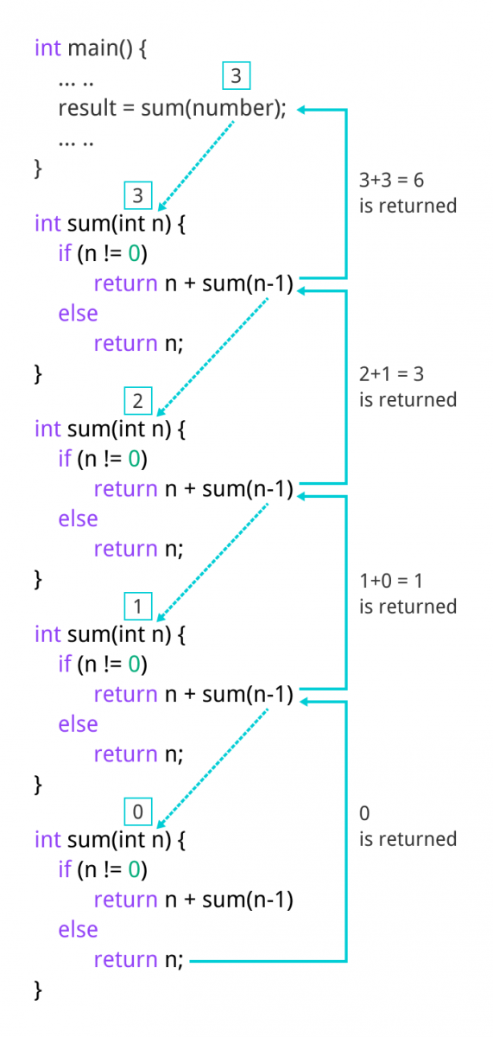
Example -RECURSION:
//program to find the sum of Natural Numbers Using Recursion
#include <stdio.h>
int sum(int n);
int main() {
int number, result;
printf("Enter a positive integer: ");
scanf("%d", &number);
result = sum(number);
printf("sum = %d", result);
return 0;
}
int sum(int n)
{
if (n != 0)
return n + sum(n-1); // sum() function calls itself
else
return n;
}

Slide 6
RECURSION
Create a C program to calculate the FIBONACCI SERIES using the recursion.
INPUT:
Enter n : 6
OUTPUT:
The Fibonacci series is : 0 1 1 2 3 5
LOGIC:
Read n;
Declare a recursive function fib()
Define fib(n) to recursively call n*fin(n-1)
Call fib() in main()

Slide 7
Example -RECURSION:
//PROGRAM FOR FIBONACCI SERIES
#include<stdio.h>
void fib(int n)
{
int n1=0,n2=1,n3;
if(n>0)
{
n3 = n1 + n2;
n1 = n2;
n2 = n3;
printf("%d ",n3);
fib(n-1);
}
}
int main(){
int n;
printf("Enter the number of elements: ");
scanf("%d ",&n);
printf("Fibonacci Series: ");
printf("%d %d ",0,1);
fib(n-2); //n-2 because 2 numbers are already printed
return 0;
}

Slide 8
RECURSION- ADVANTAGES
Recursive functions are very useful to solve many mathematical problems, such as calculating the factorial of a number, generating Fibonacci series, etc
To solve such problems which are naturally recursive.
Reduce unnecessary calling of function.
Extremely useful when applying the same solution.
Recursion reduce the length of code.
It is very useful in solving the data structure problem
Disadvantages of recursion
Recursive functions are generally slower than non-recursive function.
It may require a lot of memory space to hold intermediate results on the system stacks.
Hard to analyze or understand the code.
It is not more efficient in terms of space and time complexity

